Slide 1
PQ issues
&
Iskra PQ solutions

Slide 2

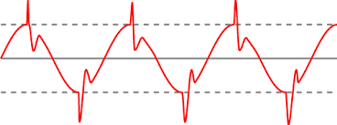
Power Supply Characteristics?
Two main indicators for a proper power supply:
Power supply interruptions (Power Outages)
Easy to detect
Causes are mostly well known
Direct influence on production process
Power supply (voltage) Quality
Mostly hard to detect
Causes are not always clear
Indirect influence to production process

Slide 3
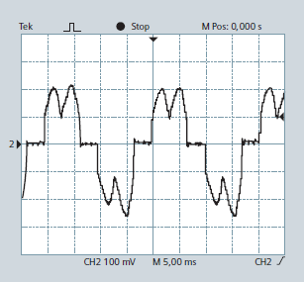
Why measure Power Quality?
Reasons for Power Quality monitoring
    Increase of use of power electronics
      frequency inverters
      switching power supplies
      non-linear loads, modern lightning...
    Increase of unbalanced and non-linear loads like large furnaces and rectifiers
    Liberalization of energy markets
      More demanding power regulation due to increase of grid connected renewable energy sources
      Reduction of infrastructure investments

Slide 4
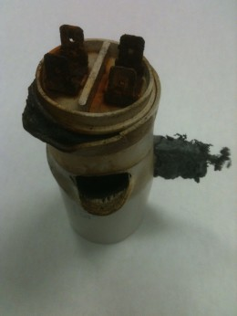
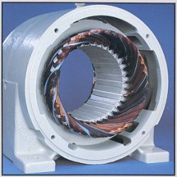
Bad Power Quality consequences
Economical aspects
Business normal operation can be interrupted causing significant economic damage
Power blackouts in wider residential and business areas
Interconnecting (exporting/importing) different distribution power grids may not be possible
Technical aspects
Malfunction of domestic appliances, medical equipment, laboratory apparatus...
Burn-out of heavy industrial motors due to voltage unbalance
Ageing and destruction of power factor correction capacitors due to harmonic currents
Stopping and/or resetting of control systems that are dependent on a computer due to voltage interruptions

Slide 5
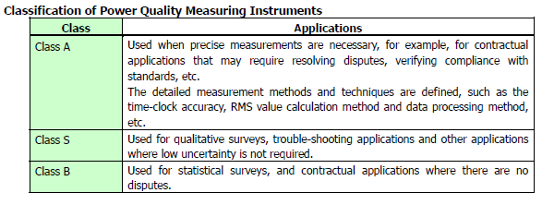
How to measure Power Quality?
Step 1: Measurement methods for PQ analysers
    Power Quality parameters can not be measured by standard measuring devices used for voltage/current/power… monitoring
    Only Class A Power Quality analysers can be used for that purpose.
    Proper methodes are defined with IEC 61000-4-30 Ed.3 standard and sub-standards for harmonic analysis and flickers
    Measuring methods define principles for PQ parameters acquisition

Slide 6
How do we evaluate Power Quality?
Step 2: Evaluation methods for issuing PQ compliance reports
    They are defined with EN 50160 standard.
    Limit lines and allowed time of non-compliance for monitored values listed in a table below are defined within this standard.
    Weekly PQ reports for determination of overall PQ compliance
    Anomaly detailed recording (waveforms, RMS trend…) is usefull for post-analysis of events
Phenomena | PQ Parameters
Frequency variations | Frequency distortion
Voltage variations | Voltage fluctuation
 | Voltage unbalance
Voltage changes | Rapid voltage changes
 | Flicker
Voltage events | Voltage dips
 | Voltage interruptions
 | Voltage swells
Harmonics & THD | Harmonics
 | Interharmonics
 | Signalling voltage

Slide 7
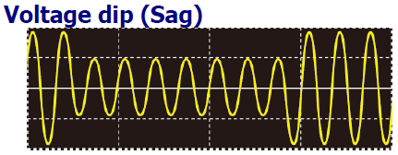
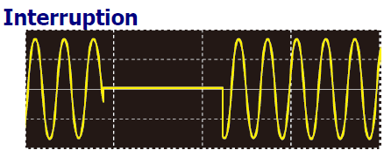
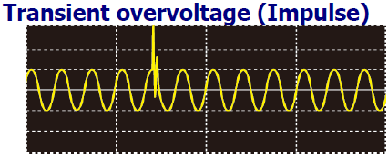
Expenses due to PQ problems
Voltage events (dips, swells, transients and interruptions)
    Generated by natural phenomena (lightning), tripping of the circuit breaker, short-circuits...
Consequences are
  stop or reset of equipment (computers, industry controlling systems and even UPS),
  speed change of motors,
  generator synchronisation failures,
  lighting malfunction...
Associated expenses
Industrial production downtime (blown fuses)
Increase of UPS cycling
Bad product quality

Slide 8
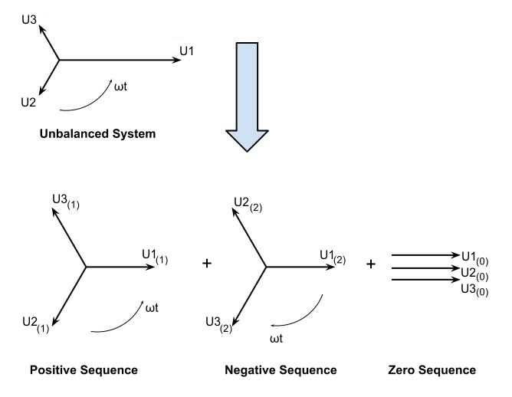
Expenses due to PQ problems
Voltage unbalance and instability
  Generated by heavy loads connected to individual phase, damaged inverters, phase or neutral loss, power theft...
Consequences are
  motor operation (revolution) faults and reduction of efficiency,
  neutral line overloading,
  increasing heat of motors and power lines, shortening their lifespan,
  network losses and voltage drops
Associated expenses
Industrial production downtime
Degraded motor performance
Motor replacement / refurbishment

Slide 9
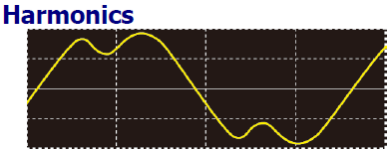
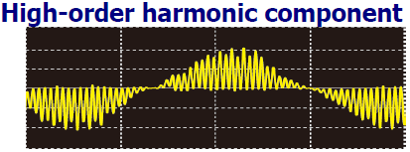
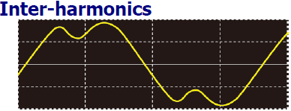
Expenses due to PQ problems
Harmonic disturbances
    Generated by semiconductor control devices, non-linear loads (LED and Fluorescent lamps), frequency inverters...
Concequences are
  overheating and failure of PF compensation capacitors, motors, cables…
  Increased power consumptiuon, increased losses,
  abnormal noise in equipment (TV, radio, medical equipment),
  misoperation of protection devices…
Associated expenses
Industrial production downtime
Degradation of PF capacitors
Communication problems (PLC)
Network and transformer losses

Slide 10
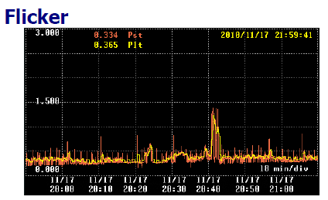
Expenses due to PQ problems
Flicker
    Generated by furnace, arc welding, thyristor controlled loads...
    Causes annoying fast changes of lighting, malfunction of sensitive equipment...
Associated expenses
Increased sick call of workers – headaches and eye problems
Bad product quality – tripped sensitive loads

Slide 11
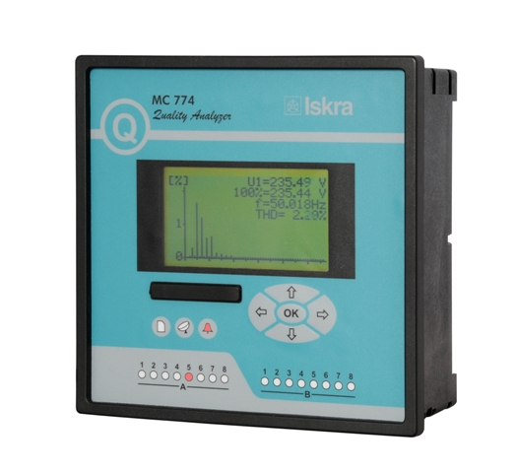
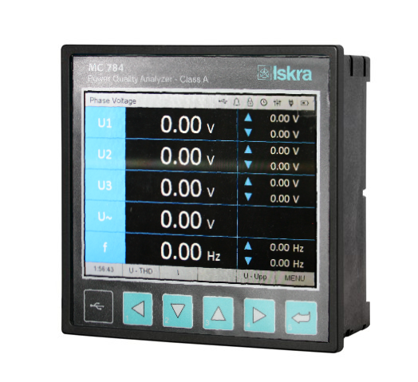
ISKRA PQ meters
MC770 – Power Quality analyser (built in Class A evaluation methods – New product!)
MC774 – Power Quality analyser (Class A certified – IEC 6100-4-30 Ed.2)
(i)MC784 – Advanced Power Quality analyser (Class A certified – IEC 6100-4-30 Ed.3)

Slide 12
Type differences - general
 | MC770 | MC774 | (i)MC784 | MC784
Power Quality analysis according to EN61000-4-30 Class A and EN50160 with automatic report generation | ✓ | ✓ | ✓ | ✓
Measurement of 4 Voltages and 4 Currents (3 Currents – type MC770) with 32 kHz sampling time and high accuracy (0.1%) | ✓ | ✓ | ✓ | ✓
Automatic measuring range up to 1000 V_{RMS} and 12.5 A direct connection | ✓ | ✓ | ✓ | ✓
Comprehensive energy measurement feature (0.2S accuracy, 4 quadrant energy measurement, 8 counters, up to 4 tariffs, tariff clock, pulse outputs...) | ✓ | ✓ | ✓ | ✓
Two serial COM ports and (or – type MC770) USB and Ethernet communication with support for MODBUS and DNP3 protocol. | ✓ | ✓ | ✓ | ✓
Internal memory (8MB) for recording all measured parameters (1min resolution), alarms, PQ reports and time-stamped details about anomalies. | ✓ | ✓ | ✓ | ✓
Internal memory (up to 8GB) for recording all measured parameters (1s resolution) and waveforms in standard PQDIFF and COMTRADE data format | ✗ | ✗ | ✓ | ✓
Waveform and transient recorder with programmable sampling time (> 600 samples / cycle), pre-trigger and post-trigger time | ✗ | ✗ | ✓ | ✓
IEC61850 protocol support | ✗ | ✗ | ✓ | ✓
Large TFT screen for enhanced graphical presentation of measured parameters | ✗ | ✗ | ✓ | ✗
Class A certificate | ✗ | ✓ | ✓ | ✓

Slide 13
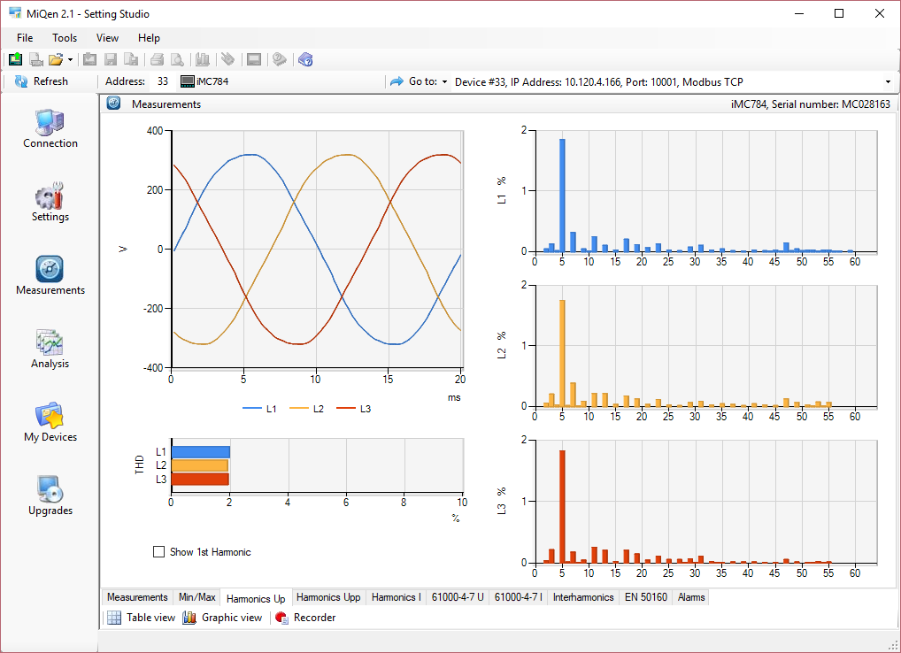
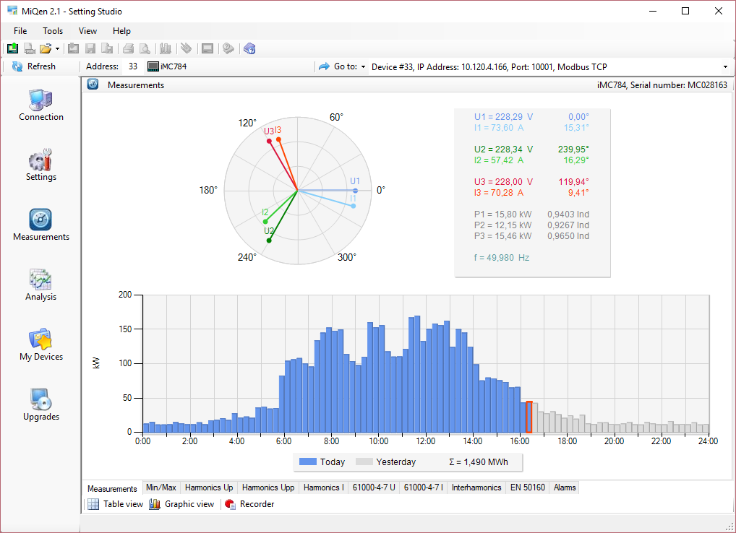
Principle of operation
32kHz sampling on U and I channels
High accuracy 0.1%
All measurements according to 61000-4-30 (measurement methods)
PQ evaluation according to EN50160 (evaluation)
Wide range of I/O modules
Real time synchronisation
User friendly software (MiQen 2.1 – free)

Slide 14
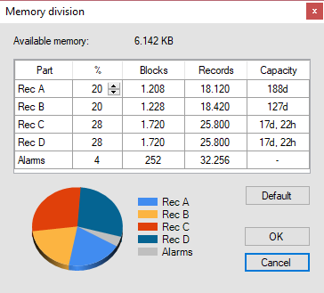
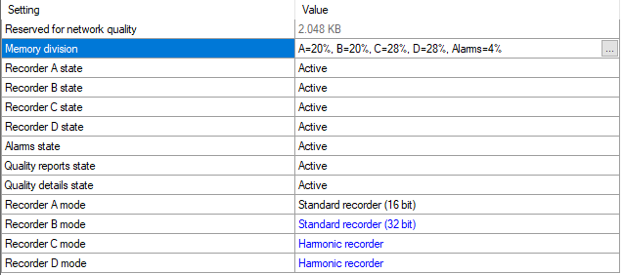
Memory - Standard recorders
32 measured values for each of four Trend recorders
Event logging (Alarms)
PQ section
Data available via MiQen SW
Capacity 8MB

Slide 15
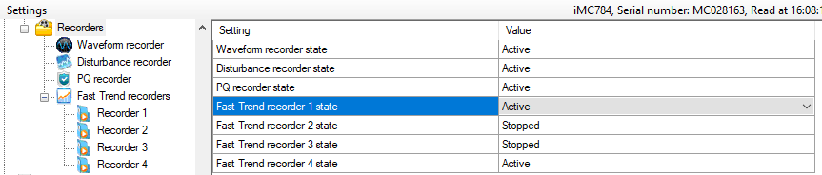
(i)MC784 – Advanced records
Records in standardized Pqdif or Comtrade (waveforms and ½ period RMS values) format
Each recorder all quantities (min, max, avg) – min 1s resolution
Files available on FTP server
Capacity 8GB

Slide 16
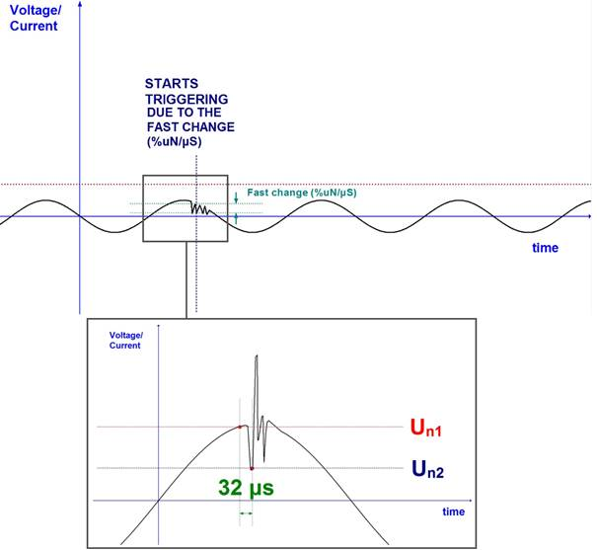
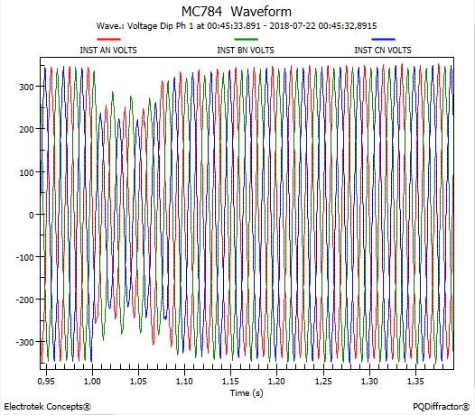
(i)MC784 - triggers
  Transient triggers with settings for different transient types, for voltages and currents
  PQ related triggers defined with EN50160 (interruptions, dips, swells, RVC…)
  Triggers driven by digital inputs when external process needs to trigger an event
  Combined and conditional triggers enable selective detection of events (secondary protection functions)
  Ethernet triggers (crosstriggers) enable sending and receiving triggers to other PQ analysers in the network

Slide 17
Supported data formats
  Various types of data formats for exported data for optimal usage of internal memory and simple integration into existing management system
Data format | Usage | Required software | Supported by
Binary *.dd2 | Data transfer by MiQen free software and export to EXCEL | MiQEN | All ISKRA models
XML | Automatic data transfer(Push) from a device to a MiSMART server for analysis and visualisation with MiSMART client | MiSMART | All ISKRA models
PQDIFF | Standard data format for display and visualisation of trend data, events, waveforms, RMS signals, binary data… | PQ Diffractor, Pqview… | (i)MC784
COMTRADE | Standard data format for display and visualisation of trend data, events, waveforms, RMS signals, binary data… | PQ Diffractor… | (i)MC784

Slide 18
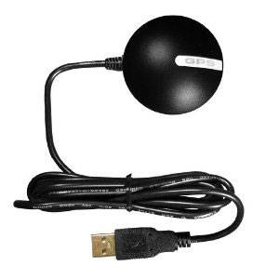
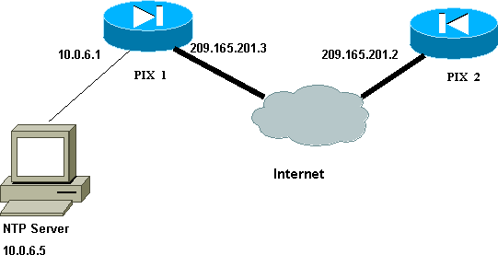
Real time synchronisation
  Accurate Real Time is an essential property for all Class A devices.
  All events are time-stamped and compared to events recorded by other devices by 1ms time-stamp resolution
  Internal time must be in all conditions accurate at least to a single period (20ms),
  Devices uses extremely precise RTC, which is even without synchronisation better then 1s / week
  Three sources for RTC synchronisation are supported:
    GPS (MC774, (i)MC784)
    IRIG – B (MC774, (i)MC784)
    NTP (All ISKRA models)

Slide 19
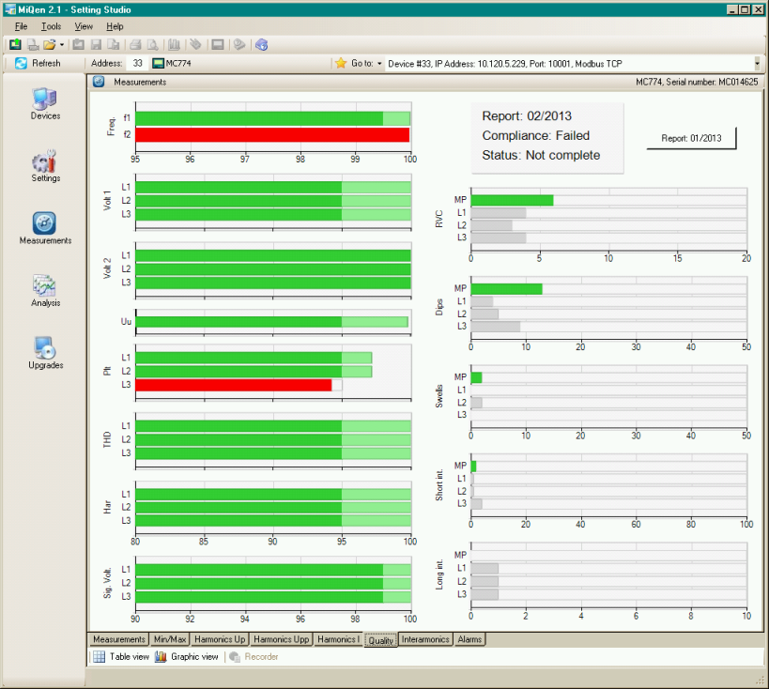
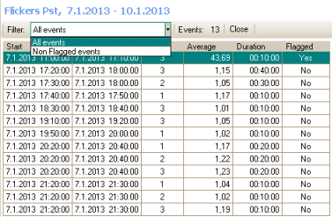
PQ analysis settings
  Accuracy and calculations are in accordance with PQ standards and certified by an authorised laboratory (MC774 & (i)MC784)
  All required aggregation intervals supported (3s, 10s, 30s, 1min, 10min, 15min, 1h, 2h)
  Flagging concept for marking simultaneous PQ events
  Multiphase events aggregation
  Pre-set limit lines in accordance with EN50160 and can be also adjusted for customized PQ reports

Slide 20
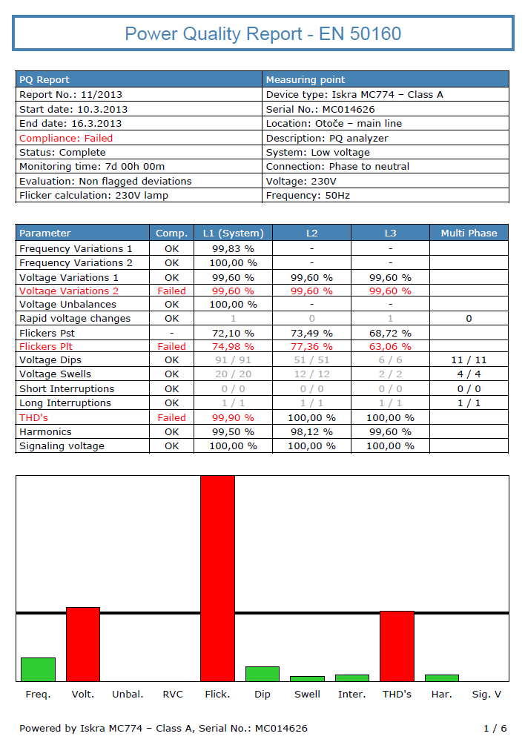
PQ reports
  Automatic weekly reports and anomaly details
  According to standard or customized limit lines
  Reports are regulatory required in most countries
  Graphical presentation of the report for fast overview
  Graphical presentation of the events (ITIC curve)
  Visible limit lines to check performance
  Full report available in PDF format

Slide 21
Iskra for You
HEADQUARTERS: STEGNE 21 | SI-1000 LJUBLJANA | SLOVENIA
PHONE: +386 1 513 10 00 | FAX: +386 1 511 15 32
E-MAIL: INFO@ISKRA.EU |WWW.ISKRA.EU

